Slide 1
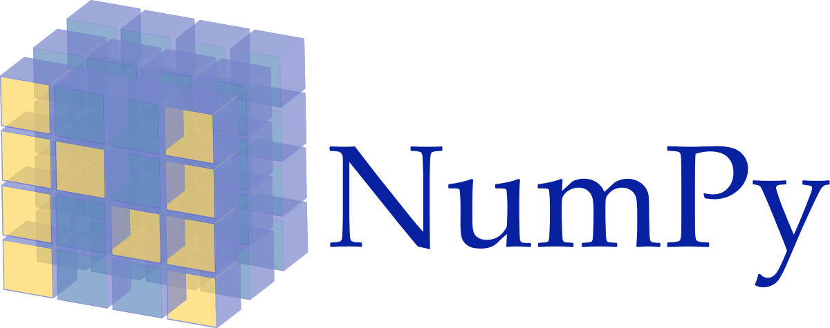
Introduction To NumPy

Slide 2
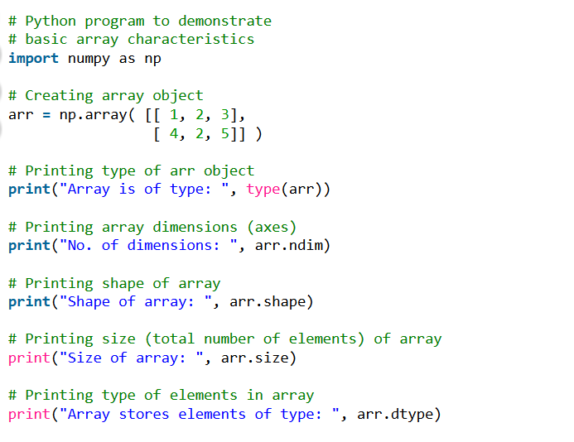
Arrays in NumPy:

Slide 3
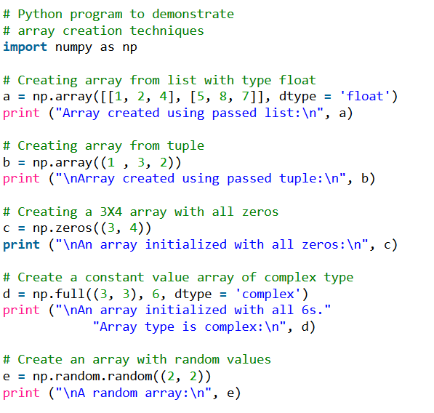
Array creation

Slide 4
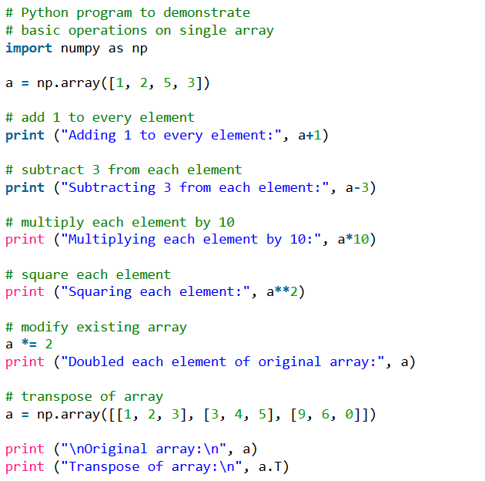
Basic operations

Slide 5
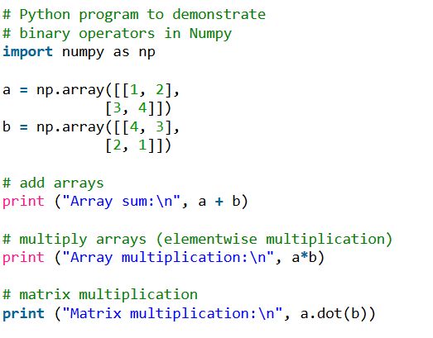
Binary operators

Slide 6

Pandas

Slide 7
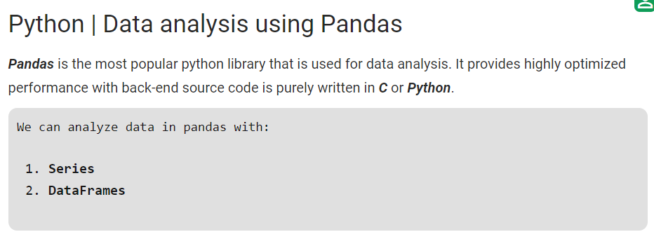
Introduction to Pandas

Slide 8
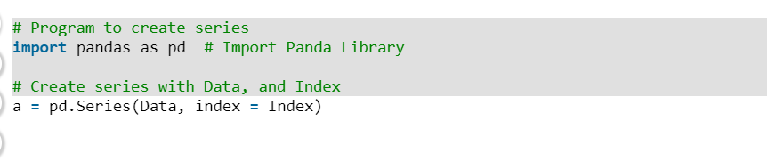
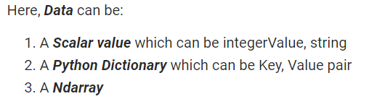
Creating Series

Slide 9
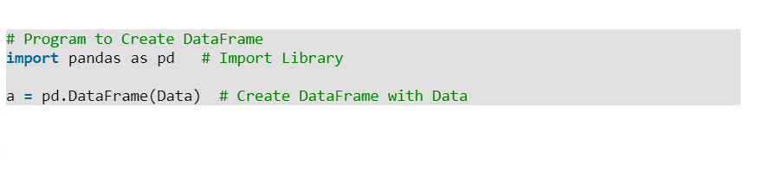
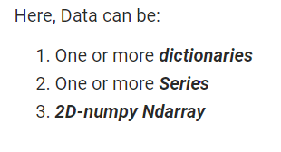
Creating Dataframe

Slide 10
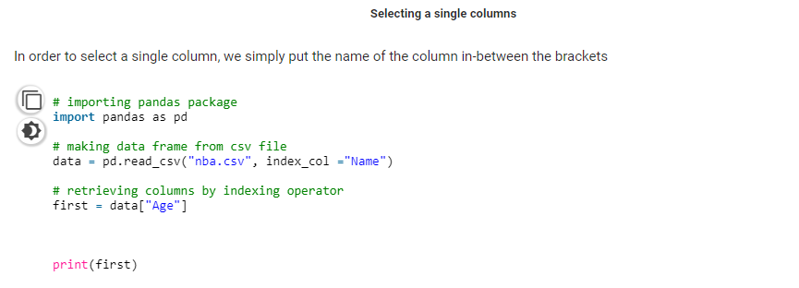
Indexing And Selecting Data

Slide 11
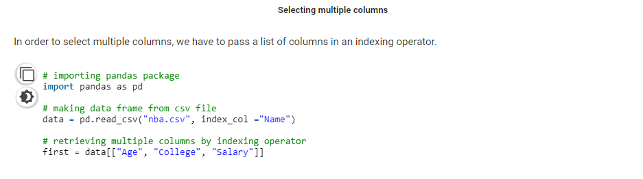

Slide 12
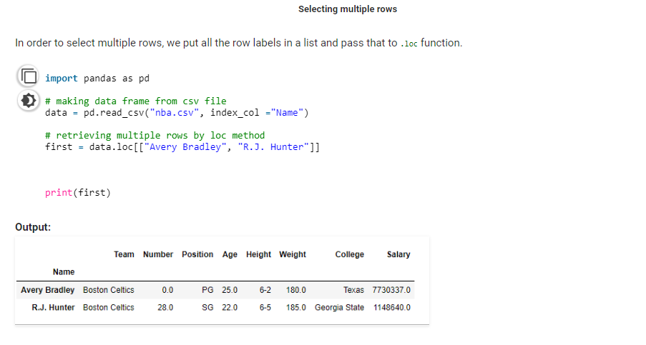

Slide 13
CONTACT US
O7Services ,
Near Narinder Cinema,Jalandhar
Contact :
8699131010
6280905038
karan@o7services.com

